Slide 1


Group 5
Project Mentor – KARTHIK MUSKULA
Oil Price Prediction

Slide 2
Oil Price prediction – Problem statement
By using the dataset, we need to analyze the historical prices and predict or forecast future prices.
Oil is a product that moves in completely different directions for a single market event because oil prices are rarely based on real-time data and are instead driven by externalities, making forecasting it even more difficult. As the economy will be highly affected by oil prices, our model will help to understand the pattern in prices to help customers and businesses make smart decisions.

Slide 3

Business Understanding:
1
Crude oil price movements are influenced by a variety of factors. This dataset was retrieved from the U.S. Energy Information Administration.
2
The aim of this dataset and work is to predict future crude oil prices based on the historical data available in the dataset.
The data contains daily Brent oil prices from the 29th of January 1998 until the 29th of January 2023.
3
Objective of the Analysis:
Because oil prices are rarely based on real-time data and are instead driven by externalities, it is difficult to forecast. As the economy will be highly affected by oil prices, our model will help understand the pattern in prices to help customers and businesses make smart decisions.

Slide 4

Problem Statement:
Analyze past prices to predict or forecast future prices.
Input variables:
DATE
PRICE

Slide 5
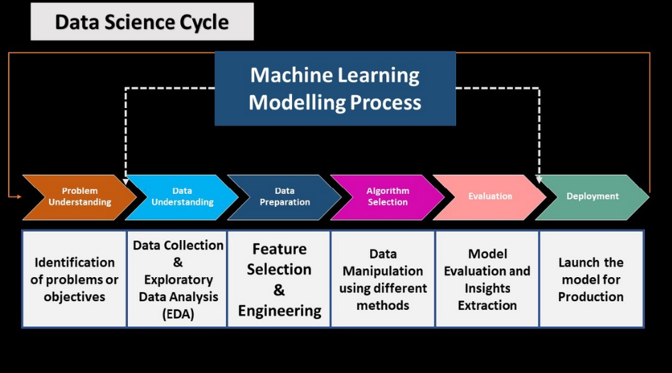
Project Workflow

Slide 6
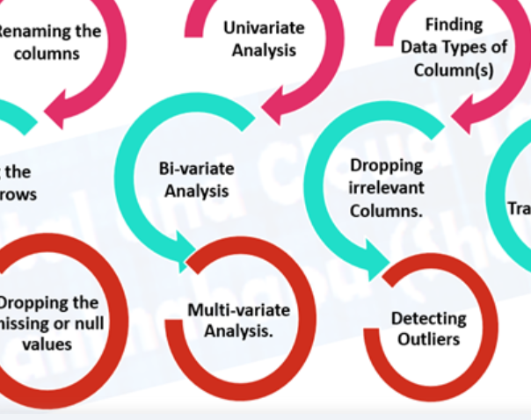

Exploratory Data Analysis (EDA)

Slide 7
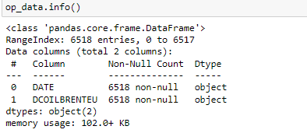
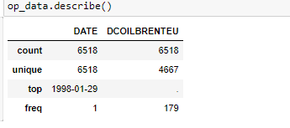
Data Set Analysis
Forecast
Date
Price

Slide 8
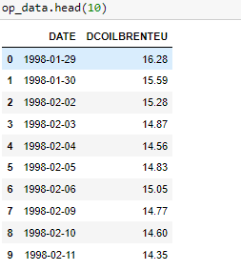
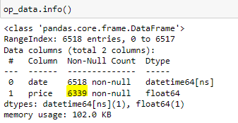
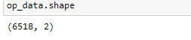
Inferences from Data Set
There are 6,518 records in the dataset without any duplicates.
The data file contains two features: date and price, and one output variable.
The datafile contained 179 null values, which were handled by interpolation.

Slide 9
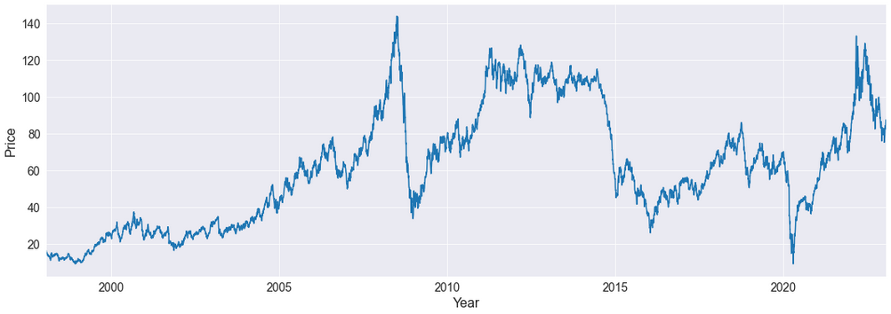
Data Visualization
From 1998 to 2006, the oil price gradually increased without much fluctuation.
But from 2007 to 2008, the oil price increased very rapidly and later decreased more rapidly.
The oil price was constant from 2011 to 2013.
In 2014, it again decreased rapidly and has remained constant until 2020.
In 2020, it rapidly decreased, and later, it gradually increased up until 2022.

Slide 10
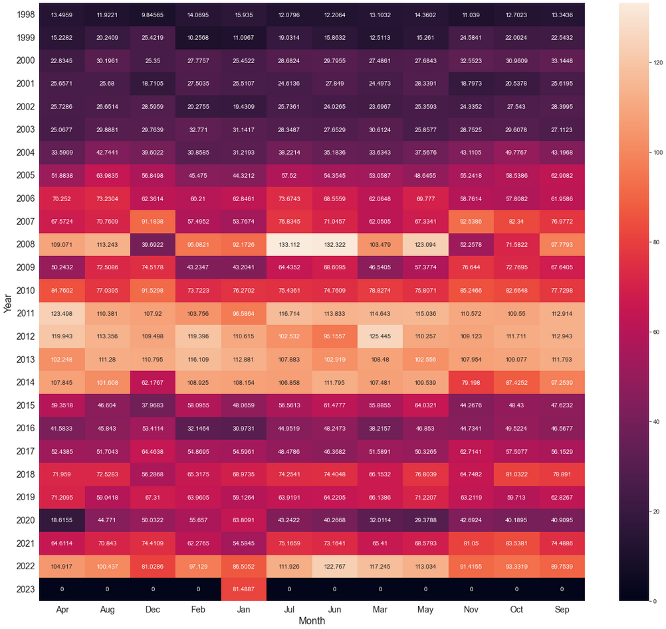
Data Visualization-Heat Map
Heatmaps are a method of representing data graphically where values are depicted by color, making it easy to visualize complex data and understand it briefly.
We can see how prices are distributed by year and month. The maximum average price is in the month of July, 2008 which was $133.11.
Price variation or fluctuation can be easily identified or analyzed for each year and month combination.
Warmer colors indicate higher values, and colder colors indicate lower values. In these maps, red is the warmest color and purple is the coldest.

Slide 11
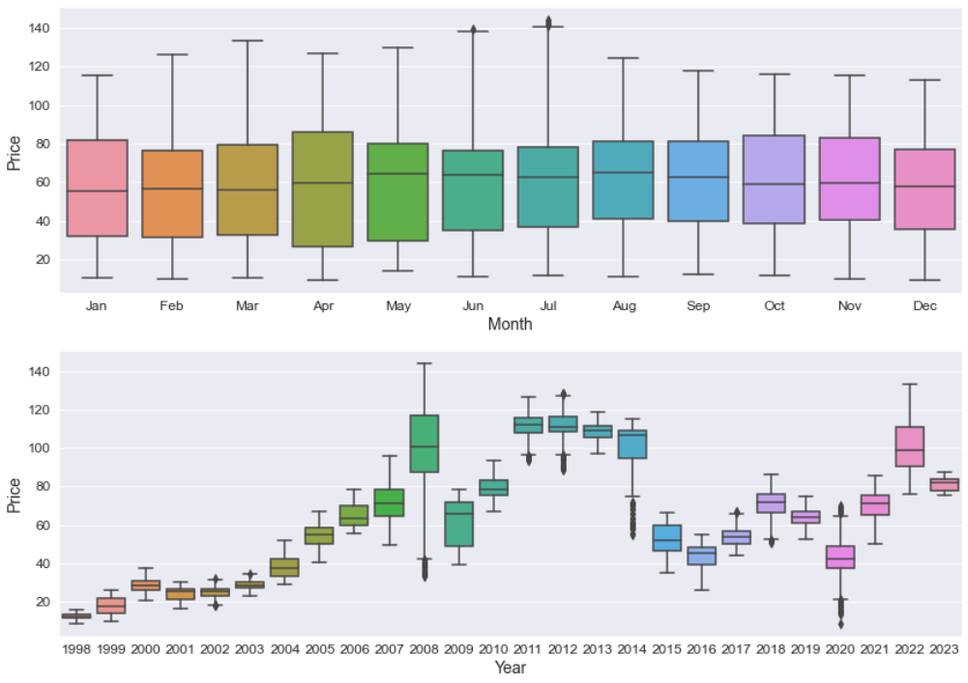
Data Visualization – Box Plot
We can see the oil price range by year and month.
Most of the years except 2008, 2014, and 2022 The box plot is comparatively short, meaning less fluctuation in terms of price.
In the year 2008, the box plot is comparatively tall, showing high fluctuations in price.

Slide 12
Reasons for the drop in oil prices
The 2008 financial crisis and the Great Recession that followed had a pronounced negative impact on the oil and gas sector as it led to a steep decline in oil and gas prices and a contraction in credit. The decline in prices resulted in falling revenues for oil and gas companies.
The price of a barrel of crude oil decreased from $133.88 to $39.09 in just a less than a year.
The recession led to a general drop in asset prices around the world as credit contracted and earnings projections fell.
At the same time, rising unemployment and lower spending led to less demand for oil by both consumers and businesses.
The initial drop in oil prices from mid-2014 to early 2015 was primarily driven by supply factors, including booming U.S. oil production, receding geopolitical concerns, and shifting OPEC policies.
However, deteriorating demand prospects played a role as well, particularly from mid-2015 to early 2016.
Oversupply of crude oil compared to demand caused the drop in Oil prices.
In 2020, worldwide demand for oil fell rapidly as governments closed businesses and restricted travel due to the COVID-19 pandemic.
An oil price war between Russia and Saudi Arabia erupted in March when the two nations failed to reach a consensus on oil production levels.

Slide 13
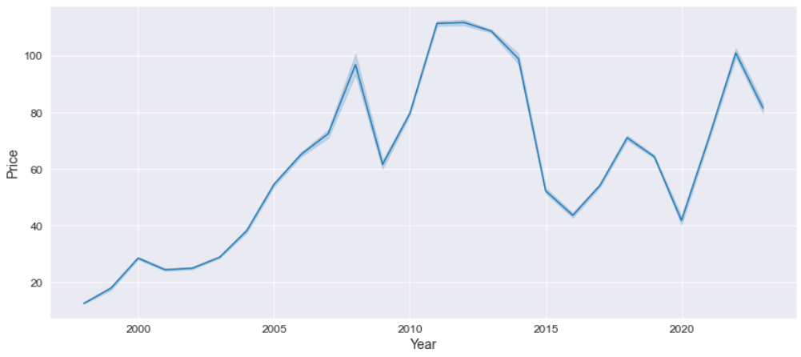
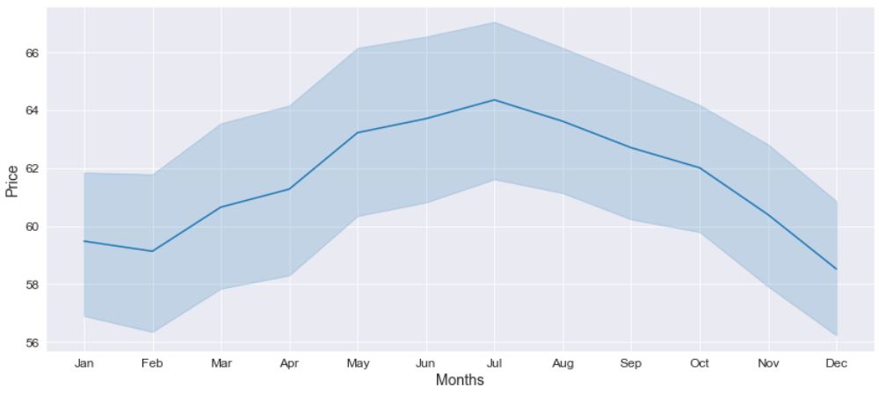
Data Visualization
Yearly Average PriceTrend
We can easily see that after a big hike from 2009 to 2011, the prices fell between 2014 and 2015. It’d be tough to interpret anything from this chart because of the high fluctuation between years, both up and down.
Monthly Average Price Trend
We can see from the LP curve that it is downward sloping by month because, as prices increase, the LP curve continues to increase but then falls or becomes u-shaped. Jan –July It is on an upward trend, but beginning in July, prices will begin to fall gradually, with a minimum price reported in December.

Slide 14
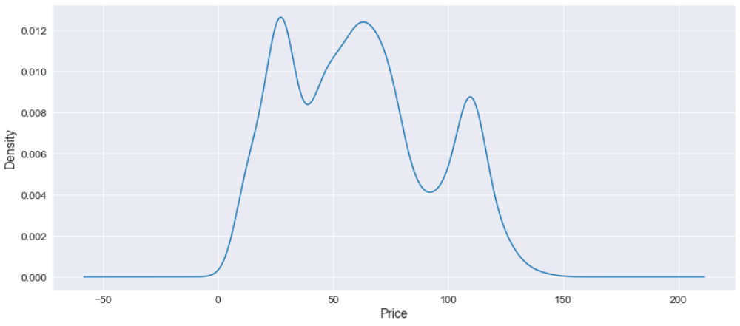
Data Visualization - Density Plot
Oil price range
Low = $20-$30.
Medium = $40-$80
High = $105-$115
A Density Plot visualizes the distribution of prices over a continuous interval or time period.
The peaks of a Density Plot help display where values are concentrated over the interval.

Slide 15
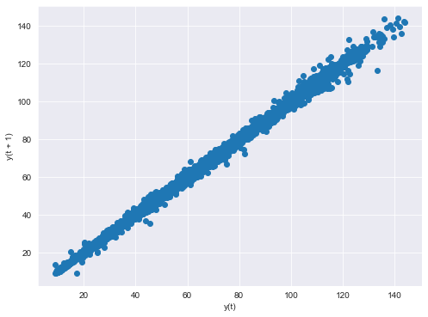
Data Visualization - Lag Plot
The shape of the lagged plot can provide clues about the underlying structure of the data. A lag plot is a scatter plot for a time series with the same data lagged.
Here the lag plot is in a linear shape, which suggests that the autocorrelation is present in the data and is positive.
More data is concentrated on the diagonal in the lag plot, which means there is a strong autocorrelation.
This lag plot also suggests that an autoregressive model is probably a better choice.

Slide 16
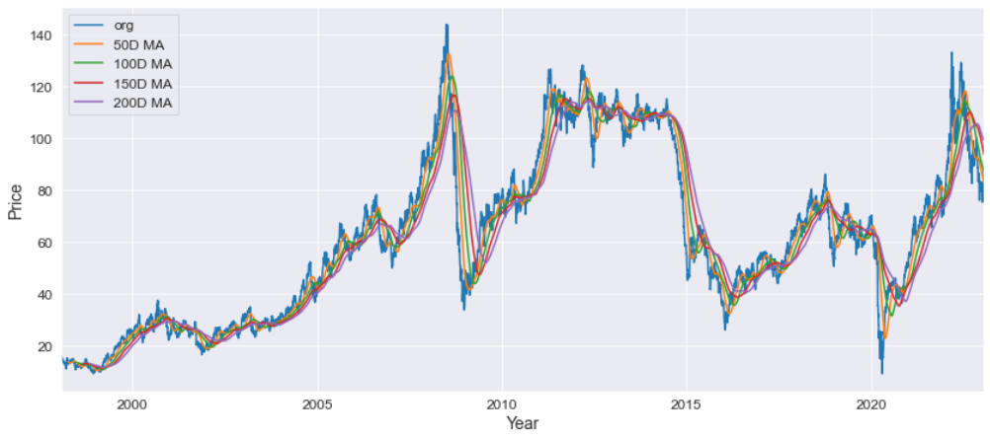
Data Visualization – Moving Average
A moving average is a statistic that captures the average change in a data series over time. Moving averages are often used to keep track of price trends for specific securities.
The 200 days moving average is showing a downward trend in the coming following days.

Slide 17
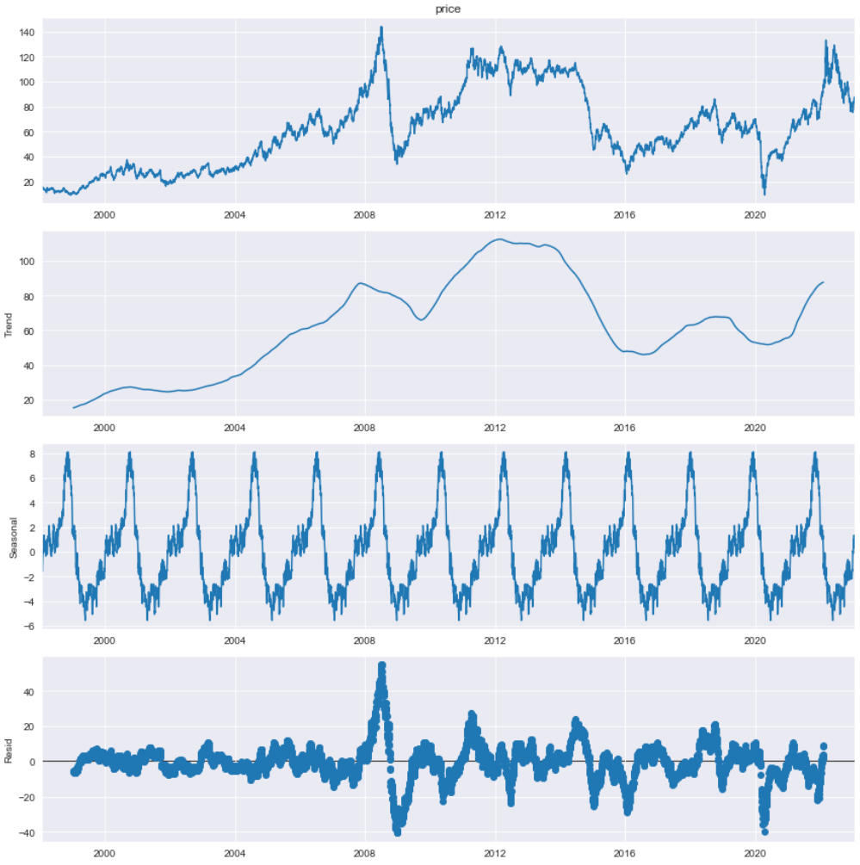
Data Visualization -Time series decomposition plot
Level: The average value in the series.
Trend: The increasing/decreasing value in the series.
Seasonality: The repeating short-term cycle in the series.
Noise: The random variation in the series.
Decomposition provides a useful abstract model for thinking about time series generally and for better understanding problems during time series analysis and forecasting.
Here we can clearly see by visualization that there is trend and season is present in the time series also the residual is showing high variability.

Slide 18
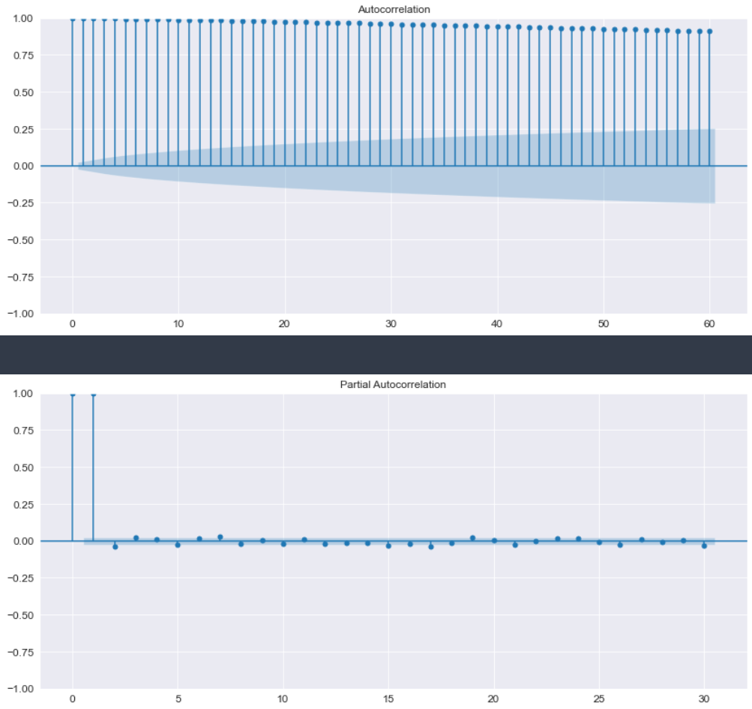
Data Visualization -Time series decomposition plot
Autocorrelation is the correlation between a time series with a lagged version of itself. The correlation between the observation at the current time spot and the observations at previous time spots, while the ACF plots the correlation coefficient against the lag, and it’s a visual representation of autocorrelation. So here there is a strong correlation even for lag=60.
Additional correlation explained by each successive lagged term. The correlation between observations at two-time spots given that we consider both observations are correlated to observations at other time spots. There is a strong correlation at lag=2

Slide 19
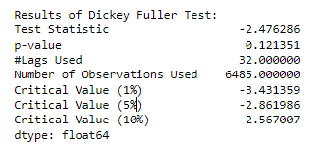
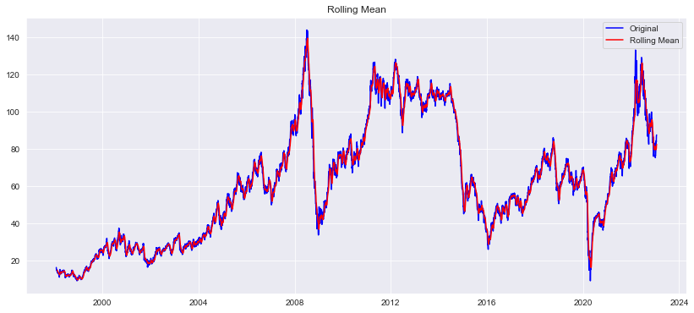
Test for Stationarity of Data
Augmented Dickey Fuller Test
Null Hypothesis (H0): The series is not stationary .
p-val > 0.05
Alternate Hypothesis (H1): The series is stationary
p-val <= 0.05
Failed to reject the Null hypothesis –Data is non-Stationary

Slide 20
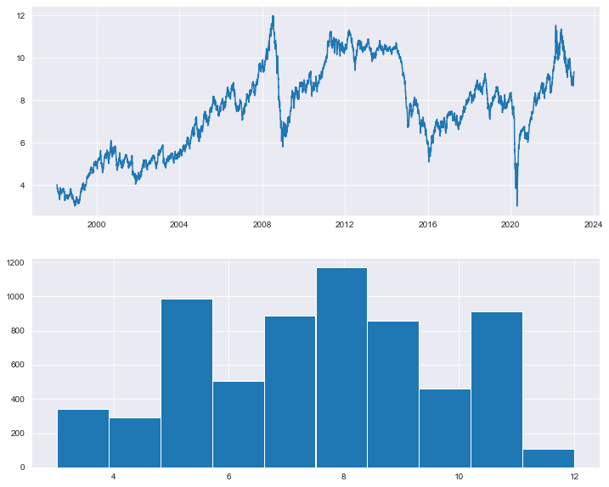
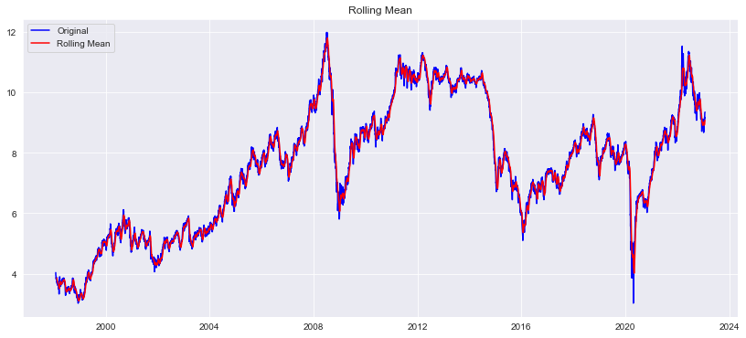
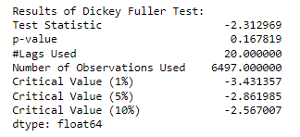
Feature Scaling (Transformations)
Square Root Transform
Failed to reject the Null hypothesis –Data is non-Stationary

Slide 21
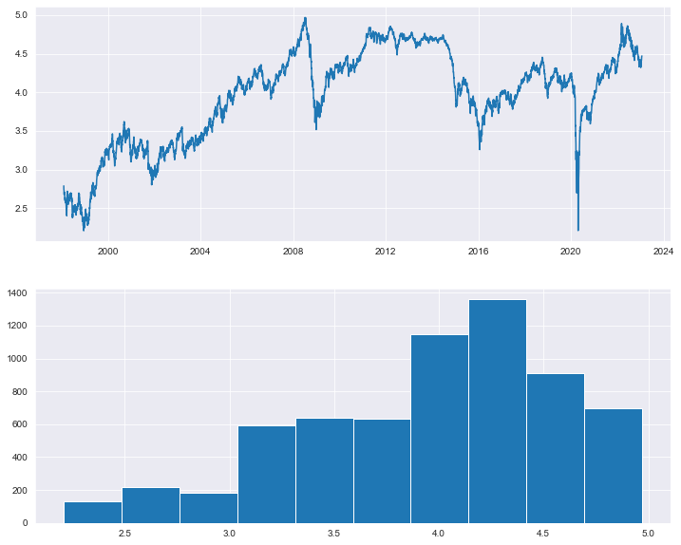
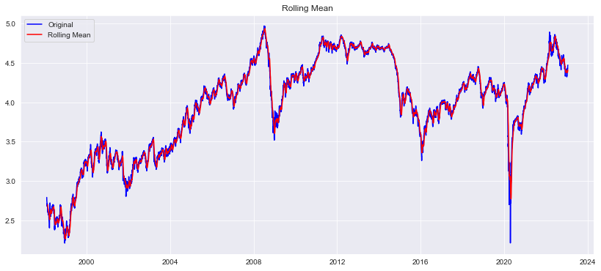
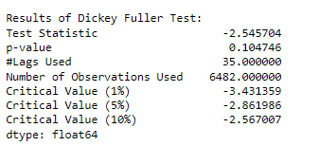
Feature Scaling (Transformations)
Log Transform
Failed to reject the Null hypothesis –Data is non-Stationary

Slide 22
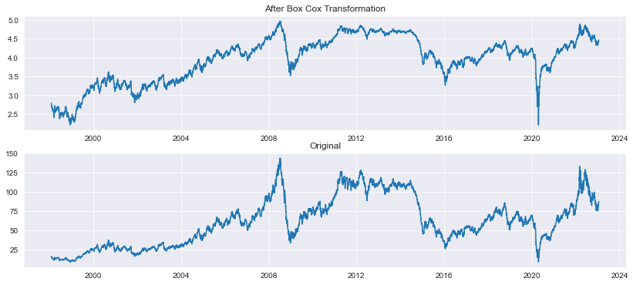
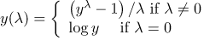
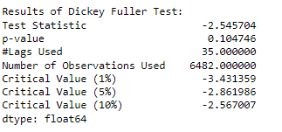
Feature Scaling (Transformations)
Box Cox Transformation
We can see the variance became almost constant after the transformation. Both in the earlier and later years ,the variance is almost similar.
However, we can see that the series is still trending upward. The mean is not zero.
Failed to reject the Null hypothesis –Data is non-Stationary

Slide 23
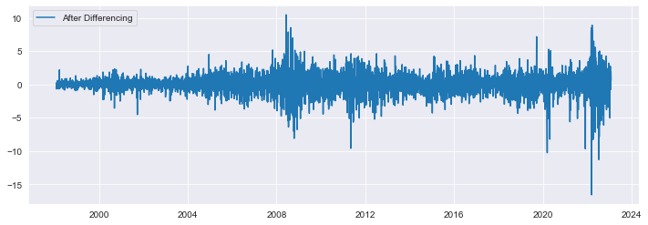
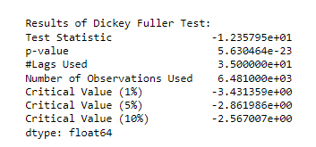
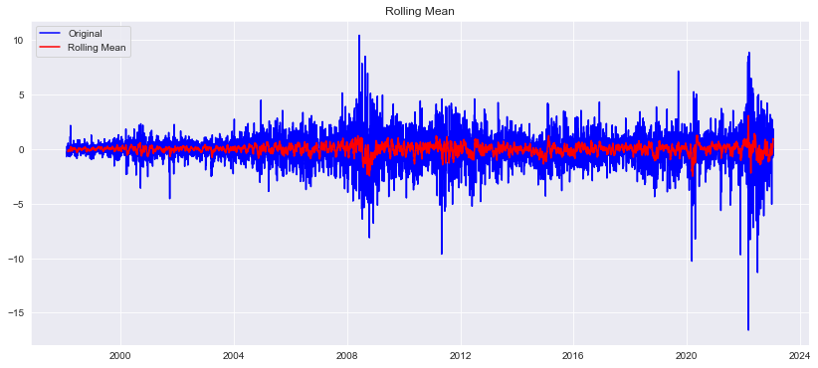
Converting Non-Stationary Time Series into Stationary
Differencing
Reject the Null hypothesis –Data is Stationary

Slide 24
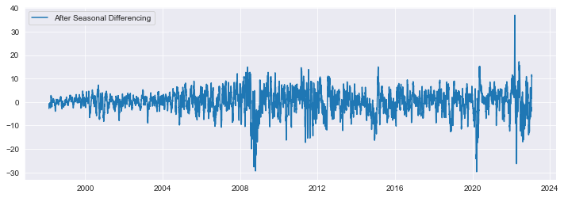
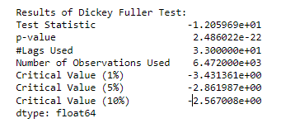
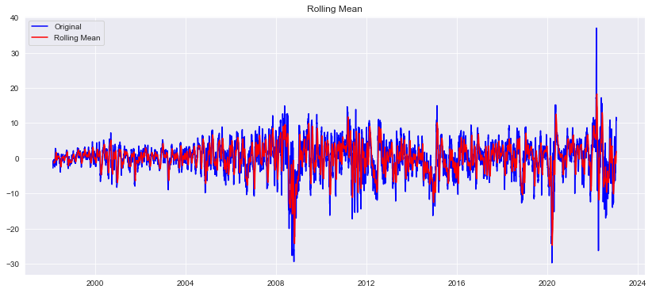
Converting Non-Stationary Time Series into Stationary
Seasonal Differencing
Reject the Null hypothesis –Data is Stationary

Slide 25
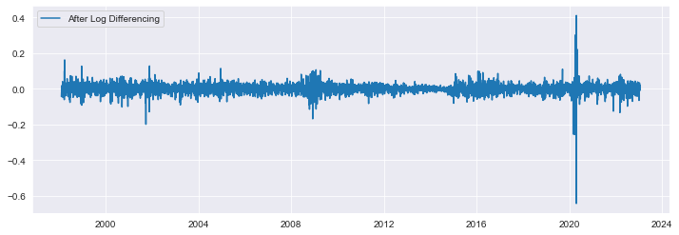
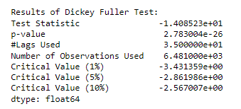
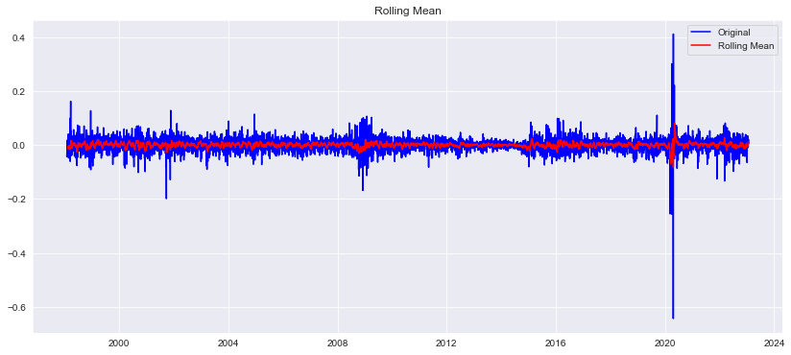
Converting Non-Stationary Time Series into Stationary
Differencing of the Log Transformation
Reject the Null hypothesis –Data is Stationary

Slide 26
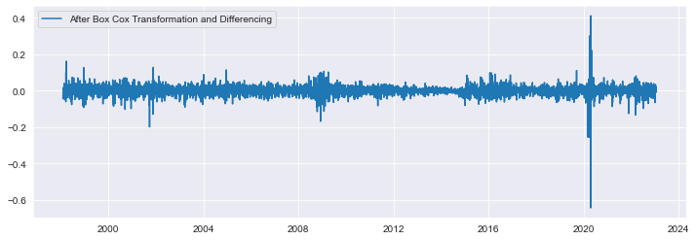
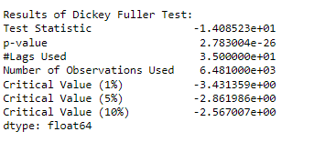
Converting Non-Stationary Time Series into Stationary
Differencing of the Box-Cox Transformation
* We can see that there is no trend (upward or downward) after differencing on the Box Cox transformation.
* It is a horizontal trend
* The mean is zero.
* The variance is almost constant
Reject the Null hypothesis –Data is Stationary

Slide 27
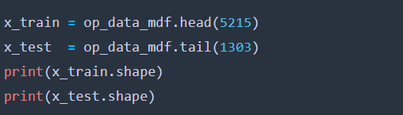

Split the data into training and testing data

Slide 28
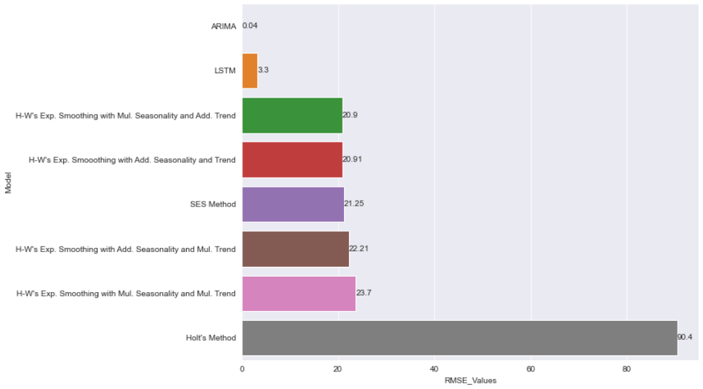
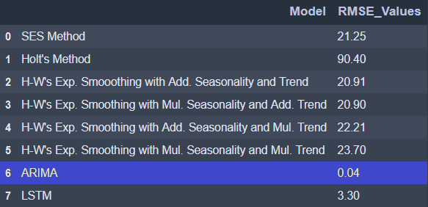
Build different models for Forecasting
Data Driven Techniques

Slide 29
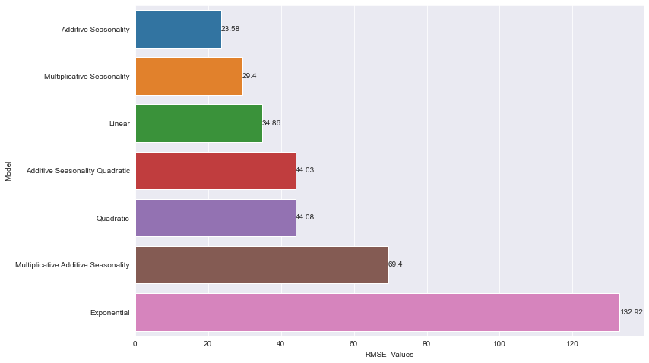
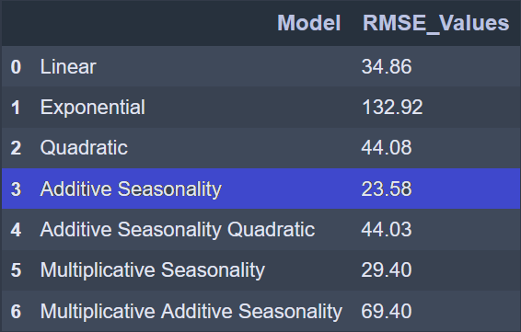
Build different models for Forecasting
Model Driven Techniques

Slide 30
Final Model
Out of all the models, ARIMA gave the lowest error. Hence use this model for forecasting.
final_model = ARIMA(op_data["price"], order=(3,1,0)).fit()

Slide 31
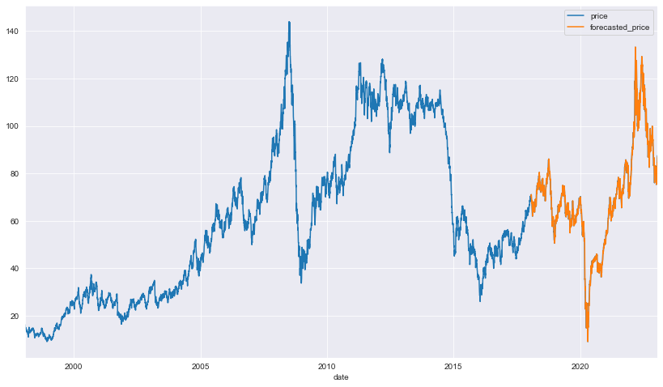
ARIMA MODEL PREDICTION
Predicted for Test Data

Slide 32
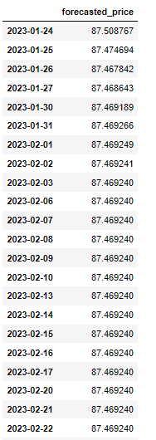
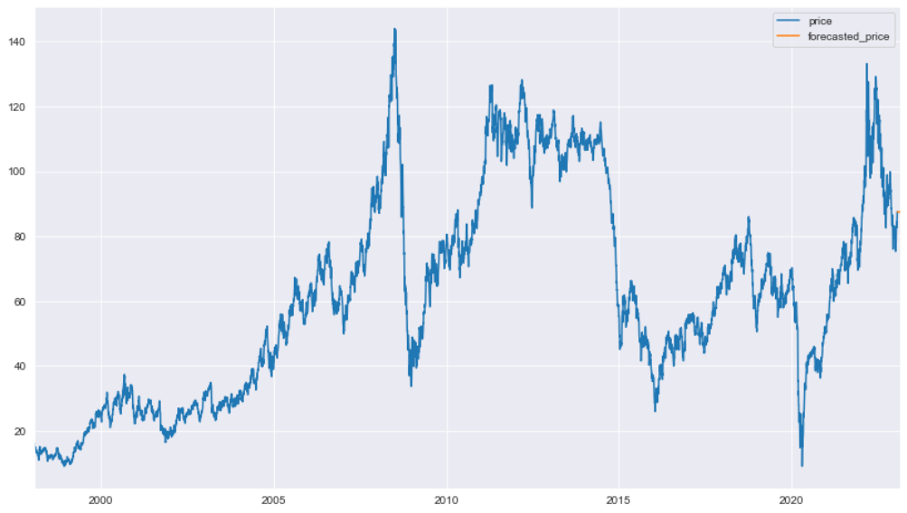
ARIMA MODEL PREDICTION
Predicted for Future Time Period

Slide 33
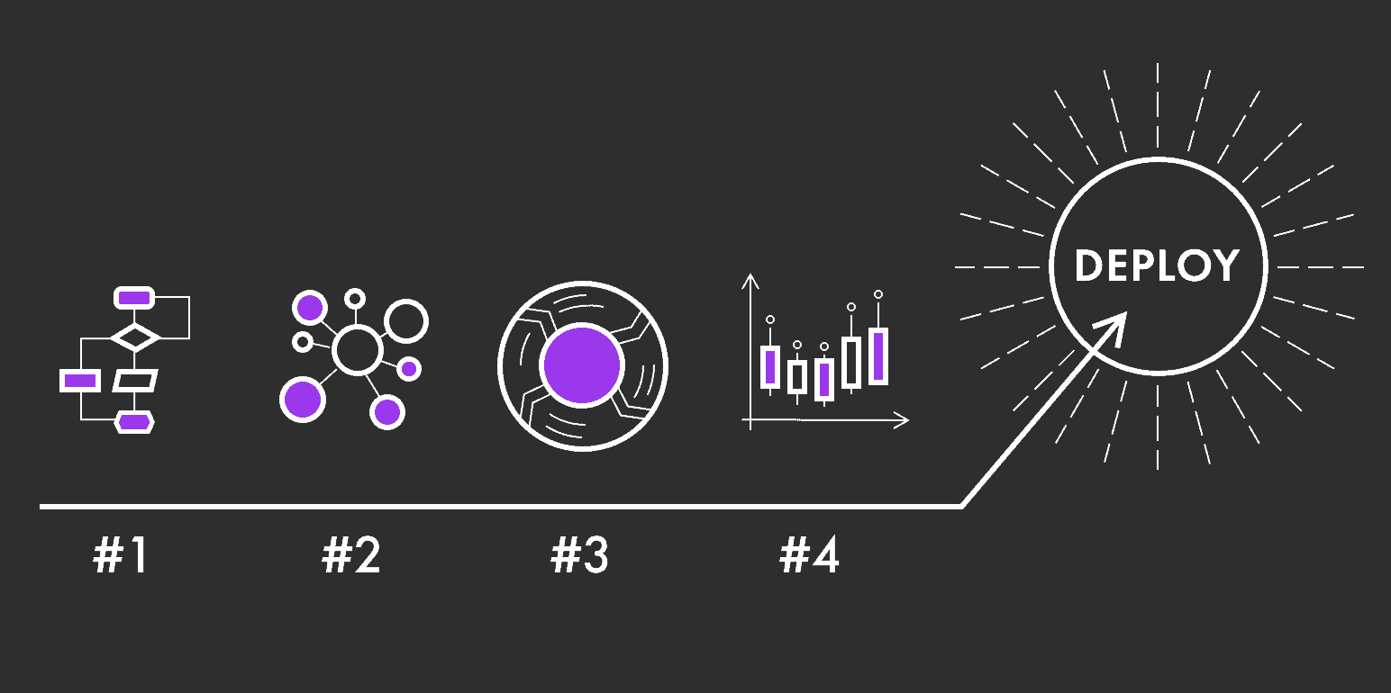
Model Deployment

Slide 34
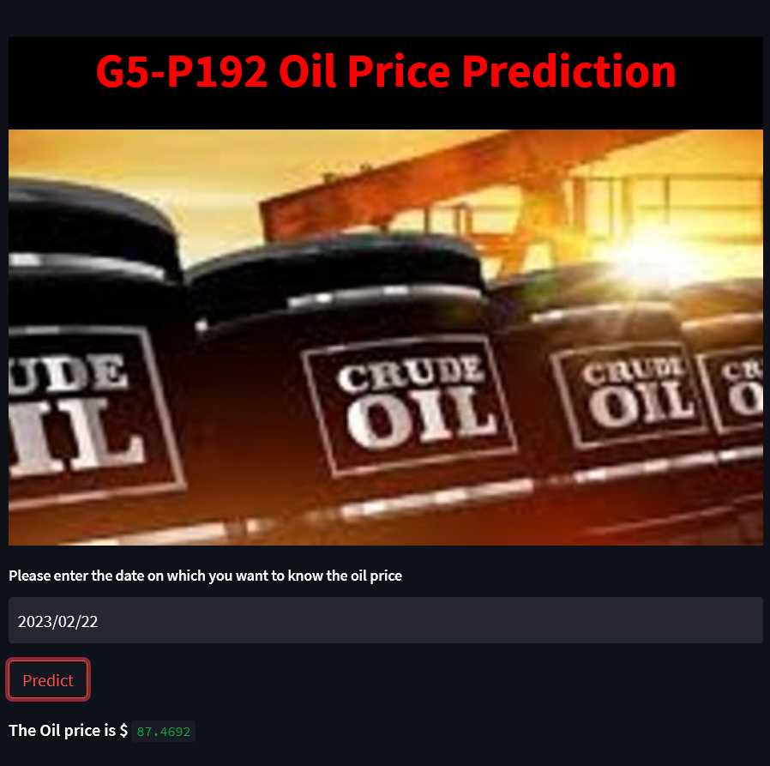
MODEL DEPLOYMENT USING STREAMLIT

Slide 35


